Slide 1

DAI Capstone
Nicholas Leong

Slide 2

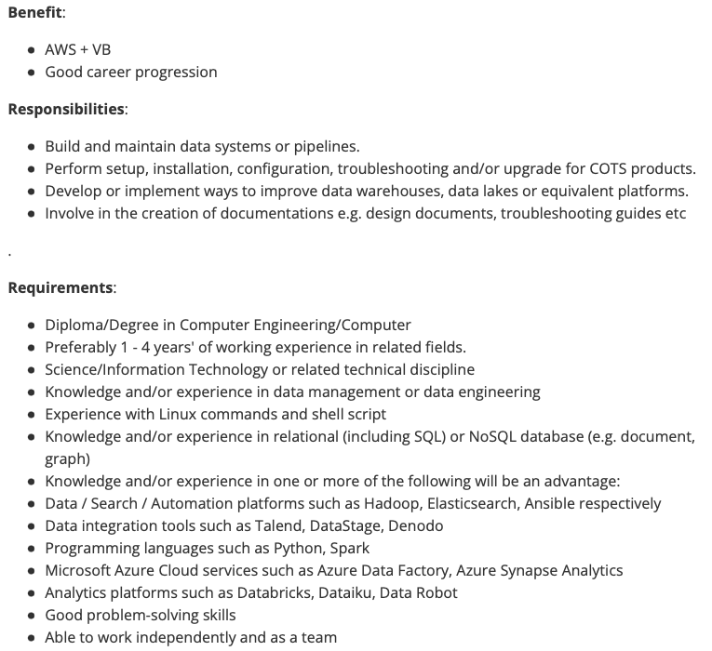
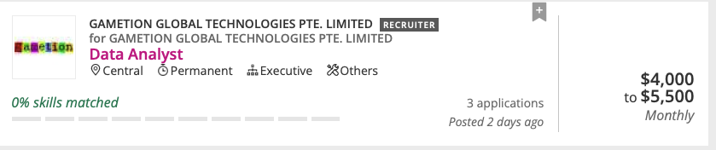
#1: Data Job Market
Problem
What are the data jobs available in Singapore right now you can apply on Job Portals?
How much do they pay? What skills do you need? How many years experience?
What kinds of industries are they? Where are they located?
What are the key words to include in your resume?
If a job requires Python, what else does it usually require?
Can we predict accurately how much you will earn based on your profile?
Solution
Data to be scraped from job site: Mycareersfuture.com -> ~ 870 search results for “data”
Stretch goal: Maybe some text analysis
Possible use case
Useful information for Job Applicants, HR, Recruiters, Data teams

Slide 3
#2: Every School a Good School
Problem:
Where should you get a home in Singapore if you are planning for / expecting a Child?
Solution:
Key in some parameters and drill down to some recommendations to start looking
What kind of parameters?
Budget
Flat characteristics (Floor, size, rooms, lease etc.)
Primary school you want (Affiliation, ranking)
Do you need preschools nearby?
Datasets:
Primary school ranking (ranked based on subscription rates)
Preschool data
Primary school data
HDB Resale Price
Condo Resale Price (2018 - 2023) by URA
Possible Use Case:
Use this spatial map as a recommender for property websites to drill down to specific listings

Slide 4
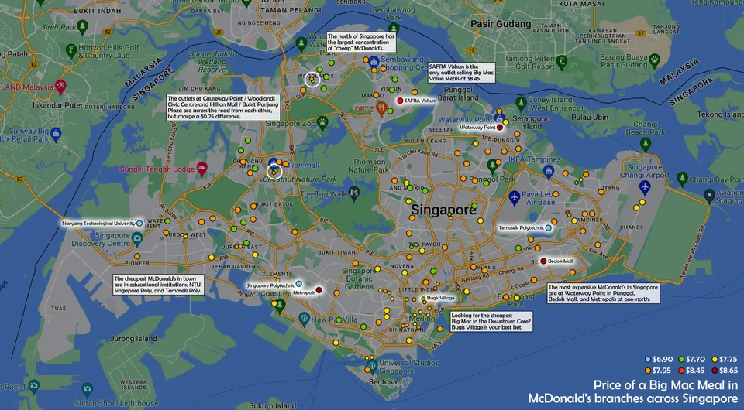
#3: McDashboard
Problem:
Life is fast paced in Singapore, where and what should you eat at McDonalds?
A Hashbrown costs $2.75 at Springleaf Tower, $2.50 at Hougang Mall and $2.30 at Bedok Mall
Choosing food is all about balancing Convenience, Price, Taste and Health
Solution:
Datasets
McDonalds Menu Nutrition (https://mcdonalds.com.sg/) / Recommended macros/calorie intake- Health
McDonalds location (web scrape from Google Maps or App) - Convenience
McDonalds Menu Prices (manually scrape from App) - Price
Content Based Filtering based on product features - Taste
A user inputs a few bookmarked locations (or none) and a few menu items they like and gets recommended purchases pushed to them. E.g. within 15 minute travel time of selected locations, what are the top N healthiest / cheapest options for a full meal/snack?
Possible Use Case:
McDonalds can integrate this feature into their app

